Slide 1
Hospital ER Simulation Prototype
Ancel Carson
Robert Zebe

Slide 2
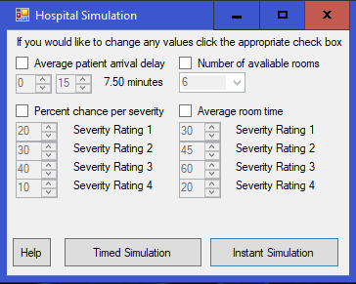
Beginning Panel
The user will check the boxes for the data fields that they want to modify and set them to their desired values

Slide 3
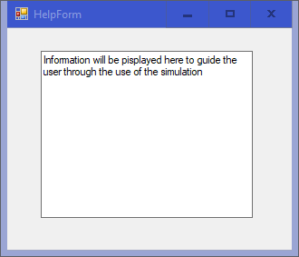
Help Panel
Currently this is mostly a place holder window. It will include details explaining how the program works and explain terminology that might be confusing.

Slide 4
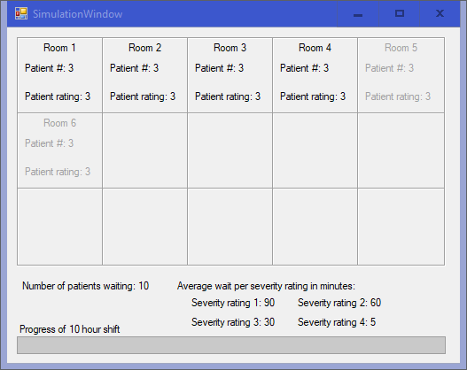
If Timed Simulation is chosen
This Panel will appear and give a 10 minute graphical simulation of patients entering and leaving rooms.

Slide 5
If Instant Simulation
A message box will appear telling the user that simulation is in progress

Slide 6
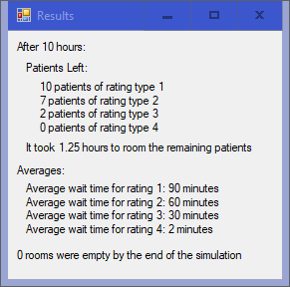
Results Panel
The result of timed simulation and instant simulation will be formatted the same. The general idea is shown below.

